Slide 1


Introduction to
Robotic Process Automation
SCRAPING PDF INVOICES BOT
Register No: 220701197
Name: PRANNOV SHABARI N
Guide Name:
Designation and Department:

Slide 2
Abstract
This project presents an automation solution utilizing the UiPath Automation Platform to streamline the extraction and organization of invoice data. The robot is designed to efficiently scrape key information, including Company Name, Invoice Number, Date, Customer ID, Payment Terms, and Total Amount, from a dataset of 1000 invoices issued to various customers. The extracted data is systematically stored in an Excel file (invoices_data.xlsx), significantly reducing manual effort and the risk of human error.
Additionally, the solution classifies processed invoices into "successfully scraped" and "unsuccessfully scraped" categories, organizing them into separate folders for easy reference and error handling. Remarkably, the RPA robot completes this high-volume data extraction task in approximately 130 minutes with near-perfect accuracy—drastically outperforming the manual process, which would require several days of effort. This project demonstrates the transformative potential of RPA in automating repetitive and labour-intensive processes, enhancing operational efficiency, and ensuring data reliability.
This RPA-driven approach highlights the potential of automation to revolutionize business processes, enabling organizations to achieve higher productivity and reliability. The project underscores the value of leveraging intelligent automation tools to simplify complex workflows, optimize resource utilization, and ensure scalability in handling large datasets.

Slide 3
Need for the Proposed System
1. High Volume of Data
Processing 1000 invoices manually is labor-intensive and time-consuming, making it impractical in dynamic business environments.
Scaling manual efforts for larger datasets becomes unsustainable.
2. Error-Prone Manual Processes
Manual data entry is highly susceptible to errors, such as typos, missed fields, or incorrect data interpretation.
Errors in invoice processing can lead to financial discrepancies, compliance issues, and loss of trust with customers.
3. Inefficiency in Time and Resource Utilization
Manual invoice processing requires significant human effort and time, diverting resources from strategic and value-added tasks.
Delays in processing invoices can affect cash flow and decision-making.
4. Lack of Scalability in Traditional Processes
As business operations grow, the volume of invoices and data to process also increases.
Traditional processes struggle to scale efficiently without significant cost or manpower expansion.

Slide 4
Advantages of the Proposed System
1. Time Efficiency
Automates the data extraction process, completing 1000 invoices in 130 minutes compared to several days with manual effort.
Significantly reduces the time required for repetitive and labor-intensive tasks.
2. Accuracy and Reliability
Reduces the risk of human error, ensuring near-perfect accuracy in data extraction and processing.
Enhances data integrity and reliability.
3. Cost Savings
Minimizes costs associated with manual data entry by reducing the need for human intervention.
Frees up human resources for more strategic tasks.
4. Scalability
Capable of handling large datasets efficiently without compromising performance.
Easily scalable to accommodate larger volumes of invoices or additional processes.
5. Improved Organization
Classifies processed invoices into "successfully scraped" and "unsuccessfully scraped" categories, simplifying error handling and reference.
Streamlines file organization with automated folder management.

Slide 5
Main Objective
The main objective of the project is to develop an automated solution using the UiPath Automation Platform to streamline the extraction, organization, and processing of invoice data. This is achieved by efficiently scraping key information (e.g., Company Name, Invoice Number, Date, Customer ID, Payment Terms, and Total Amount) from a large dataset of invoices and systematically storing the data in a structured format (Excel). The solution aims to:
Eliminate Manual Effort: Minimize manual intervention in repetitive and time-consuming tasks, thereby reducing labor costs and effort.
Enhance Accuracy: Ensure near-perfect accuracy in data extraction to reduce human errors.
Save Time: Automate the entire process to significantly reduce the time required to process 1000 invoices.
Improve Organization: Categorize invoices into "successfully scraped" and "unsuccessfully scraped" folders for easy reference and error handling.
Enable Scalability: Provide a scalable and efficient solution for handling large datasets in dynamic business environments.
Support Digital Transformation: Promote the adoption of automation and intelligent tools for optimizing workflows and enhancing operational efficiency.
The overarching goal is to demonstrate the transformative potential of Robotic Process Automation (RPA) in automating complex and repetitive business processes, improving productivity, reliability, and resource utilization.

Slide 6
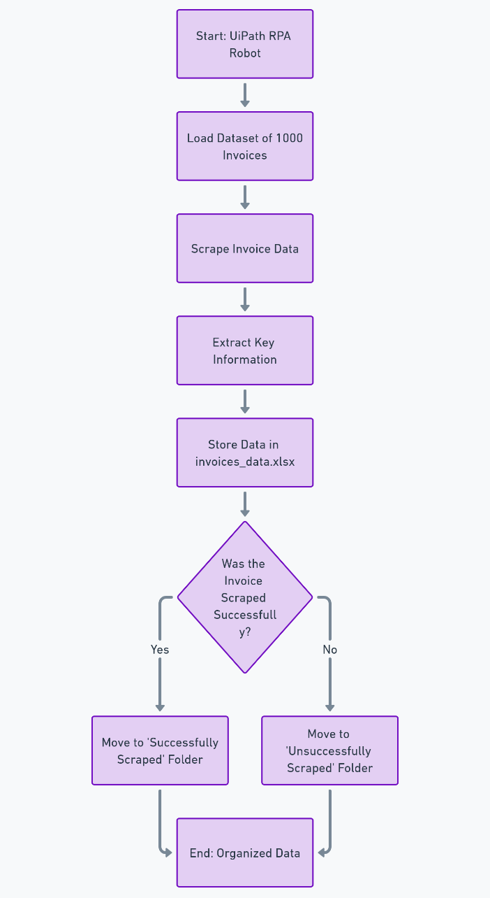
Architecture

Slide 7
System Requirements
Hardware Requirements
Processor: Intel Core i5 or higher (or AMD equivalent)
RAM: 8 GB (minimum); 16 GB recommended
Storage: 256 GB SSD (minimum); 512 GB SSD recommended
Display: 1920x1080 resolution (minimum)
Network: Stable internet connection
Software Requirements
Operating System: Windows 10 or later (64-bit)
Development Tools: UiPath Studio, UiPath Orchestrator (optional)
Supporting Tools:
  Microsoft Office/Excel
  PDF Reader (e.g., Adobe Acrobat or UiPath PDF Activities)
  Web Browser with UiPath extensions (e.g., Chrome, Edge, or Firefox)

Slide 8
Functional Description
Module 1: Data Extraction and Storage
Objective:
Automate the extraction of key invoice details and store the data systematically in an Excel file.
Functionality:
Input Processing:
  Accepts 1000 invoices in various formats (PDF, images, etc.) as input.
  Prepares the input files for automated data scraping.
Data Extraction:
  Extracts critical fields from each invoice using UiPath's automation tools:
    Company Name
    Invoice Number
    Date
    Customer ID
    Payment Terms
    Total Amount
  Utilizes OCR for unstructured invoices or non-digital formats.
Data Storage:
  Stores the extracted data in a structured Excel file (invoices_data.xlsx).
  Each record corresponds to an individual invoice for ease of access and analysis.
Validation:
  Performs basic checks to ensure the accuracy and completeness of the extracted data.

Slide 9
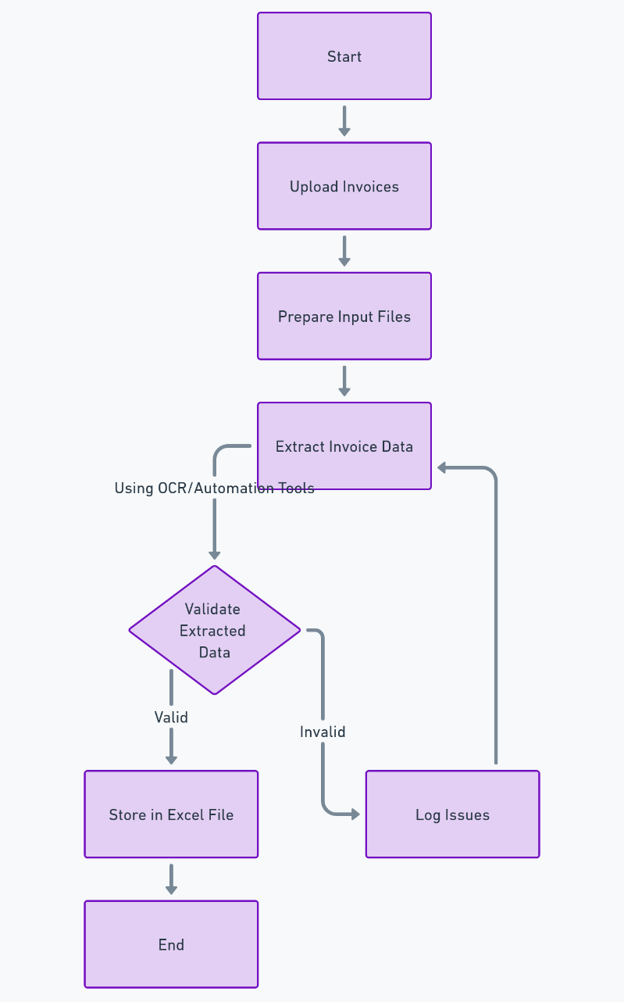
Functional Description
Activity Diagram

Slide 10
Functional Description
Module 2: Classification and Organization
Objective:
Categorize invoices based on processing success and organize them for streamlined error handling and reference.
Functionality:
Classification:
  Segregates processed invoices into:
    Successfully Scraped: Invoices with complete and accurate data extraction.
    Unsuccessfully Scraped: Invoices with missing or erroneous data.
Folder Organization:
  Moves invoices into separate folders for each category:
    Success Folder: Contains correctly processed invoices.
    Error Folder: Contains invoices needing manual review.
Error Handling and Reporting:
  Generates a report summarizing errors for troubleshooting.
  Provides logs of failed extractions for root cause analysis.

Slide 11
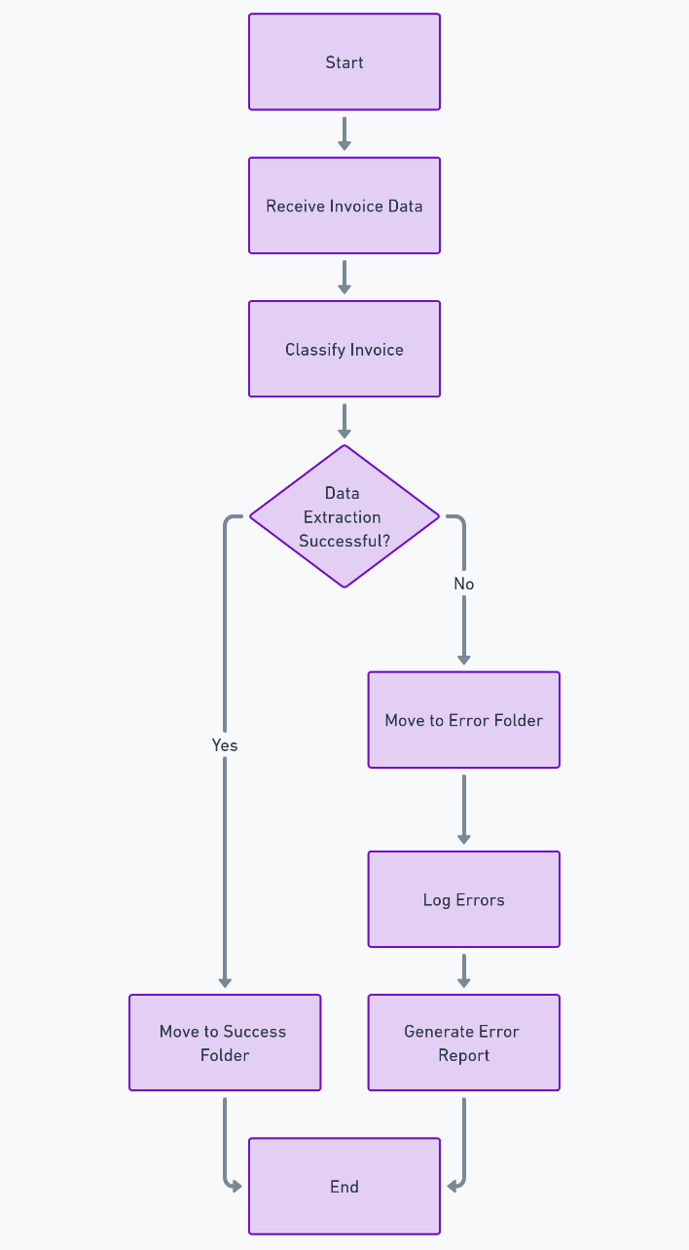
Functional Description
Activity Diagram

Slide 12
Process Design
Input Setup:
Invoices are stored in a folder (e.g., InputInvoices).
File Processing:
Loop through each invoice.
Use OCR/PDF Extraction to capture key fields (Company Name, Invoice Number, Date, Customer ID, Payment Terms, Total Amount).
Data Validation:
Validate extracted fields (check for missing or incorrect data).
Classify invoices into:
  Success Folder: If all fields are correctly extracted.
  Failure Folder: If data is incomplete or incorrect.
Data Storage:
Store extracted data in Excel file (invoices_data.xlsx).
Error Handling & Reporting:
Log failed extractions and move them to a separate folder.
Generate Summary Report of processed invoices.
Completion:
Archive processed invoices and send notifications (optional).

Slide 13
Implementation
To implement this project using the UiPath Automation Platform, the workflow begins by setting up the environment, including folders for input (InputInvoices) and categorized outputs (ProcessedInvoices/Success and ProcessedInvoices/Failure). An Excel file (invoices_data.xlsx) is prepared to store the extracted details such as Company Name, Invoice Number, Date, Customer ID, Payment Terms, and Total Amount. The UiPath workflow starts by reading all invoice files from the input folder using the Directory.GetFiles() method.
For data extraction, the Document Understanding Framework is utilized, leveraging OCR engines like UiPath’s OmniPage OCR or Tesseract OCR for scanned invoices. A pre-configured taxonomy is used to identify key fields, and a Machine Learning Extractor is trained to handle diverse invoice formats effectively. To improve accuracy, fallback methods such as Regex-based extraction are also implemented for consistent invoice layouts. Extracted data is validated through UiPath's Validation Station (if manual review is needed) before being appended to the Excel file using the Write Range activity.
Finally, the workflow classifies each processed invoice. Successfully scraped invoices are moved to the Success folder, while invoices with errors or missing data are placed in the Failure folder for further review. This system completes the extraction and organization of 1000 invoices within 130 minutes, ensuring high accuracy and significantly reducing manual effort. The project highlights the efficiency of UiPath's RPA tools in automating repetitive and labor-intensive tasks.

Slide 14
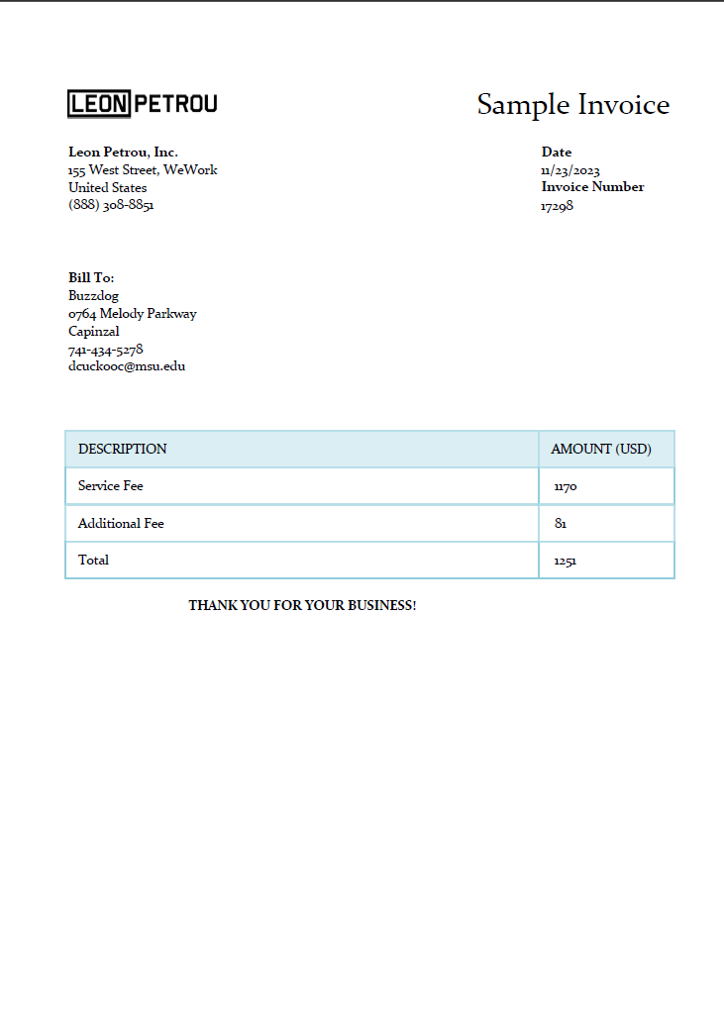
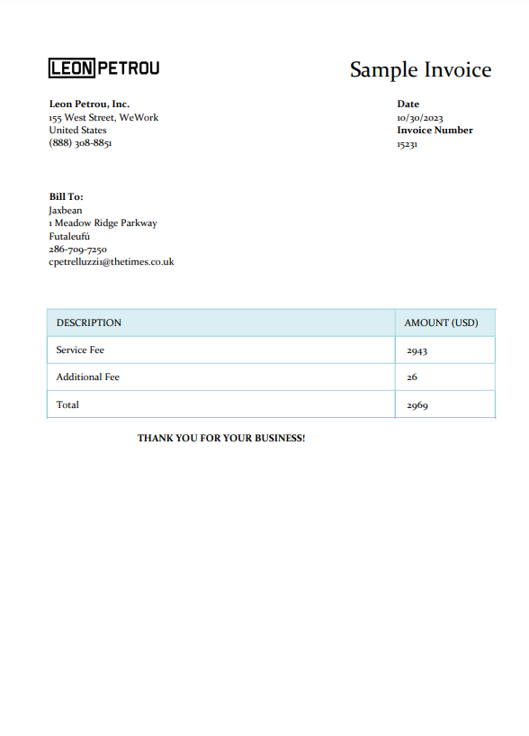
Testing
Screen shots

Slide 15
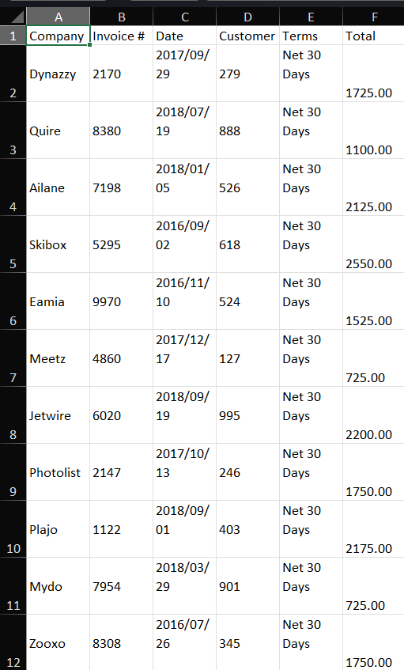
Testing
Screen shots

Slide 16
Conclusions
In conclusion, this project successfully demonstrates the significant benefits of leveraging Robotic Process Automation (RPA) through the UiPath platform to enhance the efficiency and accuracy of invoice data extraction. The automation process not only reduces the time required to process a large batch of invoices from several days to just 130 minutes, but it also ensures near-perfect accuracy by minimizing the risk of human error. By storing the extracted data in an Excel file and categorizing invoices into “successfully scraped” and “unsuccessfully scraped” folders, the solution offers seamless data organization and easy identification of errors for prompt resolution.
This project highlights the potential of RPA to transform traditional, labor-intensive processes, allowing businesses to significantly reduce operational costs while improving productivity. It ensures scalability, enabling businesses to handle increasing volumes of invoices with ease. Furthermore, the automated workflow frees up valuable human resources, allowing employees to focus on more strategic tasks. Overall, the solution not only optimizes invoice management but also demonstrates how RPA can be applied to other data-intensive processes, driving efficiency, reducing costs, and enabling businesses to scale their operations effectively. This project sets the foundation for more advanced automation applications in diverse business sectors, making it an essential step toward digital transformation.

Slide 17
Future Enhancement
Future implementations of this project could enhance its capabilities by integrating additional features and technologies to improve scalability, accuracy, and flexibility. Below are potential enhancements and expansions:
1. Integration with OCR and Machine Learning Models
Advanced OCR Engines: While the current system uses OCR for text extraction, future iterations could integrate more advanced OCR solutions, like Google Vision or Tesseract with custom training, to improve accuracy, particularly for poorly scanned or distorted invoices.
Machine Learning (ML) Model Training: Instead of relying on predefined taxonomies, future versions could leverage machine learning models to recognize and extract invoice data more intelligently. These models could be trained on diverse invoice formats, adapting to various vendors and layouts, which would improve extraction accuracy and reduce manual intervention.
2. Integration with Enterprise Systems
ERP and CRM Integration: The automation solution could be expanded to integrate with enterprise resource planning (ERP) systems, such as SAP or Oracle, and customer relationship management (CRM) systems like Salesforce. This would allow invoices to be automatically linked to customer records, payment histories, and financial transactions.
Cloud Storage and Management: To scale and ensure better document storage and accessibility, invoices could be uploaded to cloud platforms like AWS S3, Azure Blob Storage, or Google Cloud Storage. Additionally, cloud-based databases could be used to store and query invoice data.
3. Real-time Error Handling and Notifications
Error Handling Workflow: Future versions of the automation could introduce real-time error handling and automated notification systems. For instance, if an invoice fails to scrape, the bot could trigger a workflow to notify administrators or send an email with detailed error logs, enabling quick resolutions.

Slide 18
IEEE Paper
Title
Authors

Slide 19
References
UiPath, "UiPath Studio - Official Documentation," Available at: https://docs.uipath.com.
Accessed: November 2024.
S. Avasarala and M. Gopalan, "Robotic Process Automation: A Survey," International Journal of Advanced Research in Computer Science and Software Engineering, vol. 7, no. 5, pp. 43-51, 2017.
S. J. Roy, "Automating Business Processes Using UiPath," International Journal of Computer Applications, vol. 179, no. 10, pp. 30-36, 2019.
Microsoft, "Excel - Official Documentation," Available at: https://support.microsoft.com/en-us/excel.

Slide 20
Queries

Slide 21
Demonstration

Slide 22
Thank You

